Slide 1
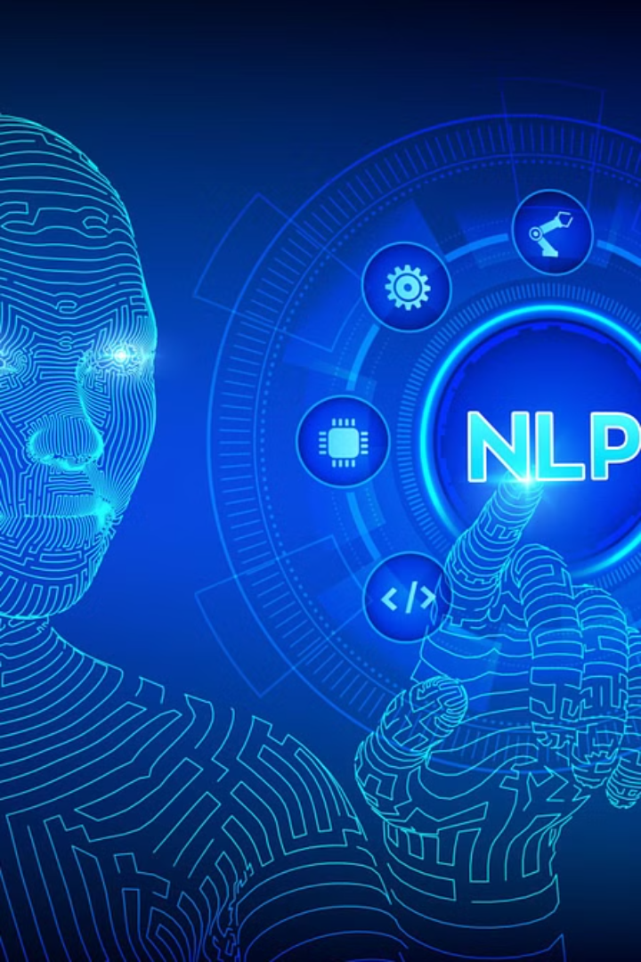
NLP Projects Idea:
SUMMARY WRITER
G.priyanka reddy- 192211645
CSA1337-Theory of computation with logical model

Slide 2
NLP Projects Idea #4: Introduction
Natural Language Processing (NLP) is a rapidly evolving field that aims to enable computers to understand, interpret, and generate human language. This project idea explores the application of NLP techniques to tackle a unique problem and deliver valuable insights. By combining cutting-edge NLP approaches with creative problem-solving, this project has the potential to push the boundaries of what's possible in the realm of language understanding and generation.

Slide 3
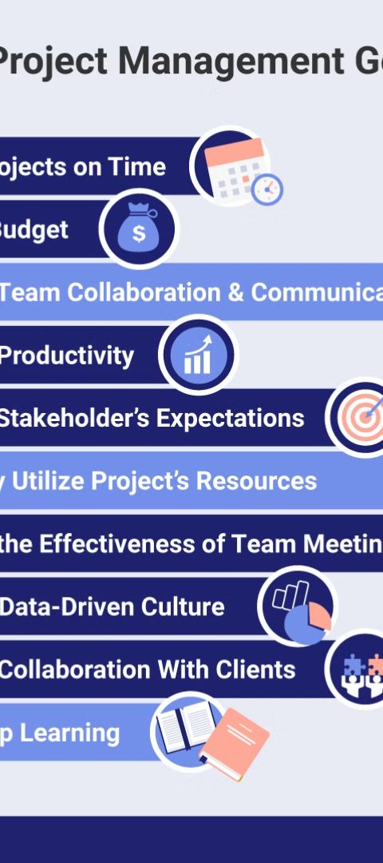
Objectives of the Project
1
Develop Advanced NLP Capabilities
The primary objective of this project is to leverage state-of-the-art NLP techniques to tackle a complex problem. This will involve exploring and implementing advanced algorithms for tasks such as text classification, sentiment analysis, named entity recognition, and language generation.
2
Deliver Meaningful Insights
The project aims to go beyond mere language processing and strive to deliver meaningful insights that can inform decision-making or enhance user experiences. By carefully designing the project's scope and objectives, the team will ensure that the outcomes have practical value and real-world applications.
3
Foster Collaborative Learning
The project will provide an opportunity for the team to engage in collaborative learning, sharing their expertise, and exploring new techniques together. This will not only enhance the project's outcomes but also contribute to the professional development of the team members.

Slide 4
Problem Definition and Algorithm
Problem Definition
Algorithm Definition
Task Definition
The project will tackle a specific problem within the realm of natural language processing. This could involve tasks such as automated text summarization, sentiment analysis, or language generation. The team will carefully define the problem, identify the key challenges, and establish clear success criteria for the project.
The team will research and select the most appropriate NLP algorithms to address the defined problem. This may involve exploring techniques such as deep learning, transformers, or rule-based approaches, depending on the nature of the problem and the available data. The algorithm will be designed to maximize performance, efficiency, and accuracy.
To achieve the project's objectives, the team will define a set of specific tasks and milestones. This may include data collection, preprocessing, model training, evaluation, and deployment. Each task will be carefully planned and executed to ensure the overall success of the project.

Slide 5

Experimental Evolution
Methodology
1
The project will follow a rigorous experimental methodology, involving data collection, model training, and systematic evaluation. The team will explore different approaches, fine-tune hyperparameters, and measure the performance of the NLP models against established benchmarks or real-world scenarios.
2
Results
The project's findings will be thoroughly documented and analyzed. The team will present the results, including performance metrics, qualitative assessments, and insights gained from the experimental process. The results will be used to refine the algorithms and determine the most effective approaches for solving the problem at hand.
Discussion
3
The team will engage in a comprehensive discussion of the project's findings, highlighting the strengths, limitations, and potential areas for improvement. This discussion will also explore the broader implications of the project's outcomes and how they can contribute to the field of natural language processing.

Slide 6

Related Work
1
Existing NLP Techniques
2
Innovative Applications
The team will conduct a thorough review of the existing literature and research in the field of natural language processing. This will involve identifying and analyzing relevant techniques, algorithms, and approaches that have been successfully applied to similar problems.
The project will also explore innovative applications of NLP that push the boundaries of what's currently possible. This may involve combining NLP with other technologies, such as computer vision or speech recognition, or applying NLP techniques to novel domains.
3
Benchmarking and Evaluation
The team will research established benchmarks and evaluation metrics used in the NLP community to assess the performance and effectiveness of their proposed solution. This will ensure that the project's outcomes can be objectively measured and compared to state-of-the-art approaches.

Slide 7
Future Work
Scalability and Efficiency
Multimodal Integration
The project will explore ways to scale the NLP algorithms and improve their efficiency, enabling them to handle larger datasets and real-time processing requirements. This may involve investigating techniques like distributed computing, transfer learning, or model optimization.
The team will consider ways to integrate the NLP capabilities with other modalities, such as computer vision or speech recognition, to create more comprehensive and powerful language understanding systems. This could involve developing multimodal architectures or leveraging cross-modal representations.
Ethical Considerations
Practical Applications
As the project explores advanced NLP techniques, the team will be mindful of the ethical implications and potential risks associated with language-based technologies. This may include addressing issues like bias, privacy, and responsible AI development.
The team will explore real-world applications and use cases for the project's NLP capabilities, identifying industries or domains where the developed solutions could have the most significant impact. This could involve collaborating with industry partners or exploring commercialization opportunities.

Slide 8
Outcomes of the Project
Technological Advancements
Practical Applications
Knowledge Sharing
The project's outcomes will be designed to have real-world applications, addressing specific problems and delivering meaningful insights. This could involve the creation of practical tools, services, or products that leverage the developed NLP capabilities to solve complex language-related challenges.
The project will involve extensive documentation, including technical reports, research papers, and tutorials. This knowledge-sharing component will contribute to the broader understanding and adoption of the project's NLP techniques, fostering collaboration and further advancements in the field.
The project will result in the development of novel NLP algorithms and techniques that push the boundaries of what's currently possible in the field. These advancements may contribute to the broader scientific community and inspire further research and innovation.

Slide 9




Conclusion
Innovative NLP Techniques
Real-World Impact
Collaborative Learning
The project's outcomes have the potential to make a significant impact in various industries and applications, driving the advancement of language-based technologies.
The project has fostered a collaborative learning environment, enabling the team to share knowledge, explore new ideas, and push the boundaries of what's possible in natural language processing.
The project has demonstrated the power of cutting-edge natural language processing techniques in tackling complex problems and delivering valuable insights.

Slide 10

Bibliography
1
Relevant Research Papers
2
Industry Resources
The team will compile a comprehensive bibliography of the research papers, articles, and reports that have informed and influenced the project's development. This will include both foundational works and cutting-edge publications in the field of natural language processing.
In addition to academic sources, the team will also explore relevant industry reports, white papers, and case studies that provide insights into the practical applications and real-world use cases of NLP technologies.
3
Educational Materials
The bibliography will include educational resources, such as online courses, tutorials, and open-source libraries, that have been instrumental in the team's understanding and implementation of the NLP techniques used in the project.

